Slide 1


AI-Based Mental Health Monitoring & Support System for Remote Workers
EAI6010 Applications of Artificial Intelligence
Fall 2023 Term
Submitted By Group 3:
Katherine Bhogal, Kavya Ashwinkumar Patel, Mohammad Movahedi, Udaikiran Ravada
Instructor: Prof. Vladimir Shapiro
Northeastern University
Date: 12th December 2023

Slide 2
Introduction
40% of fully remote and 38% of hybrid workers report increased symptoms of anxiety and depression, higher than the 35% in traditional in-person settings ​​(Mayer, 2023).
Mental health monitoring and support system especially for remote workers
Continuous monitoring and personalized support for remote workers, acknowledging the prevalence of mental health challenges in decentralized work environments
Central question: How AI can detect early signs of stress and burnout, analyse keystroke dynamics, mouse movements, and other remote work data points
Anticipating a breakthrough in a comprehensive AI solution identifying mental health concerns, offering timely, personalized support, and proactively suggesting well-being strategies.

Slide 3
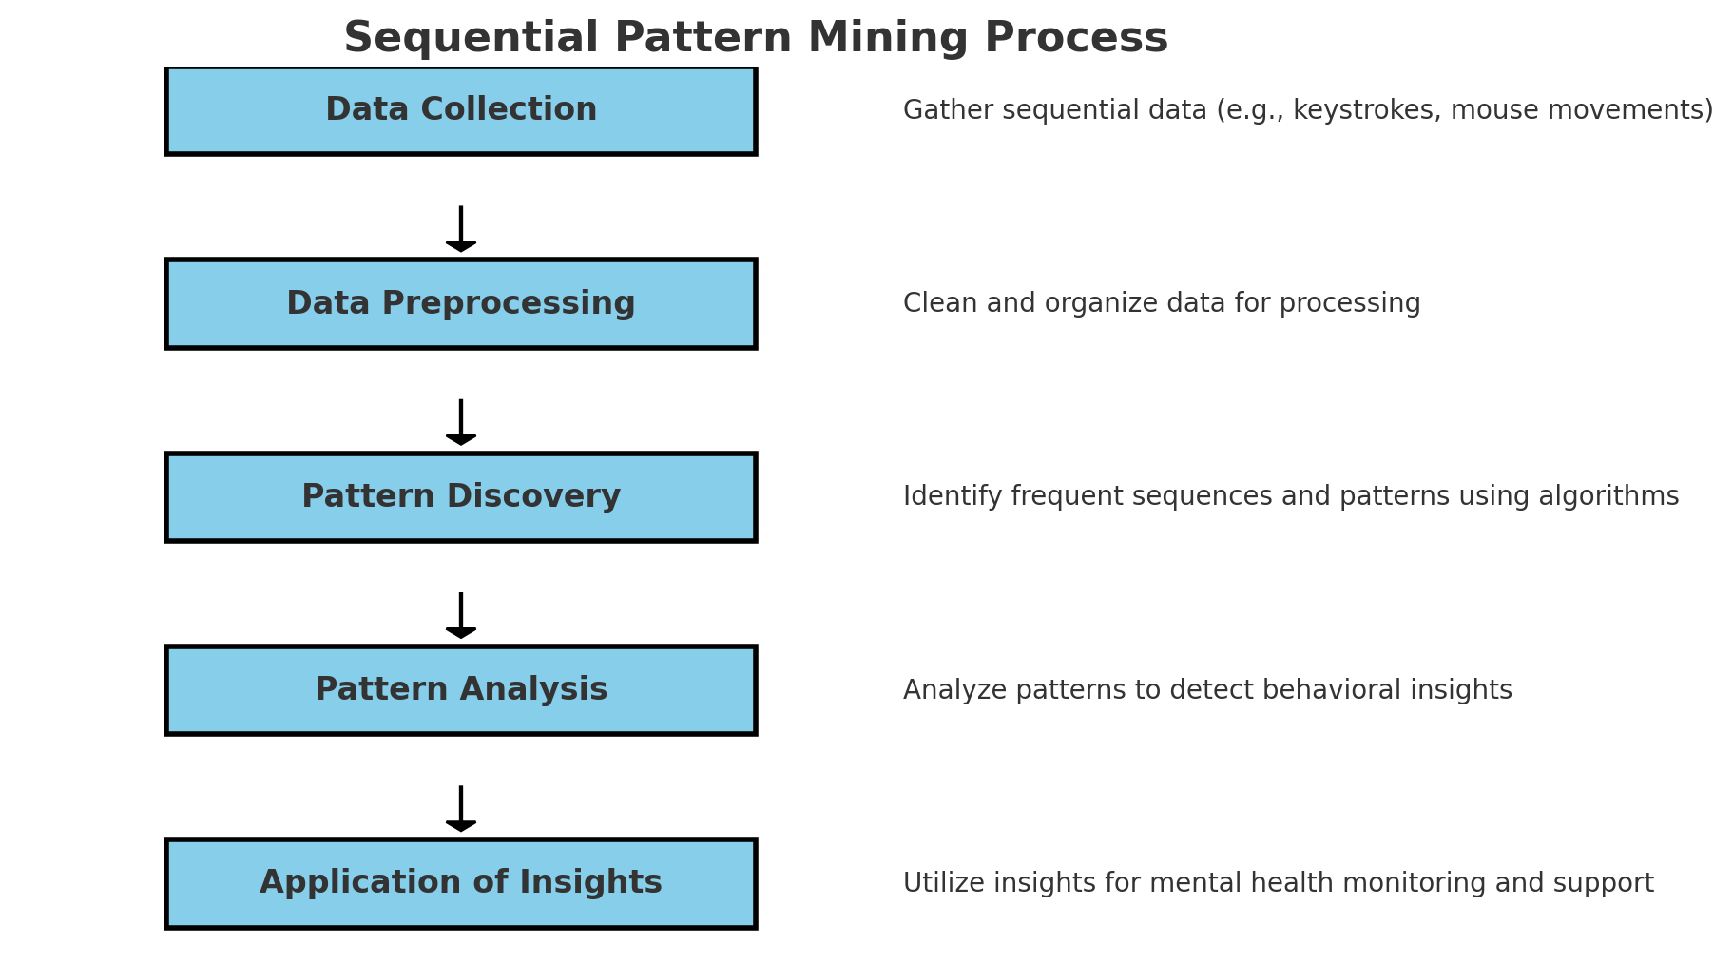
Methodology
Behavioral Pattern Analysis with AI:
Using Sequential Pattern Mining for analyzing keystroke dynamics and mouse movements(Zheng, Z. and Wei, W. 2015).
Sentiment Analysis with BERT for emotional tone in communications.
Predictive Modeling for Mental Health:
Support Vector Machines (SVM) and Neural Networks to assess mental health risks (Syed Mohamed 2023)
Reinforcement Learning for adaptive, personalized recommendations.
Key Benefits:
Accurate detection of stress or fatigue signs through nuanced data analysis.
Tailored interventions and proactive well-being strategies based on individual behavior patterns.

Slide 4
Methodology
Tailoring Mental Health Support with AI:
Collaborative Filtering for personalized resource recommendations.
Deep Learning in NLP for understanding individual needs and preferences.
AI Software Deployment & Integration:
Hosted on a secure cloud platform for scalability and accessibility.
Integrated seamlessly with existing workplace tools and HR systems.
Accessible via web and mobile applications, ensuring convenience for remote workers.
Delivery of Recommendations:
Recommendations delivered through an interactive AI chatbot, offering a conversational and user-friendly experience.
Option for users to receive notifications for timely mental health tips and resources.

Slide 5
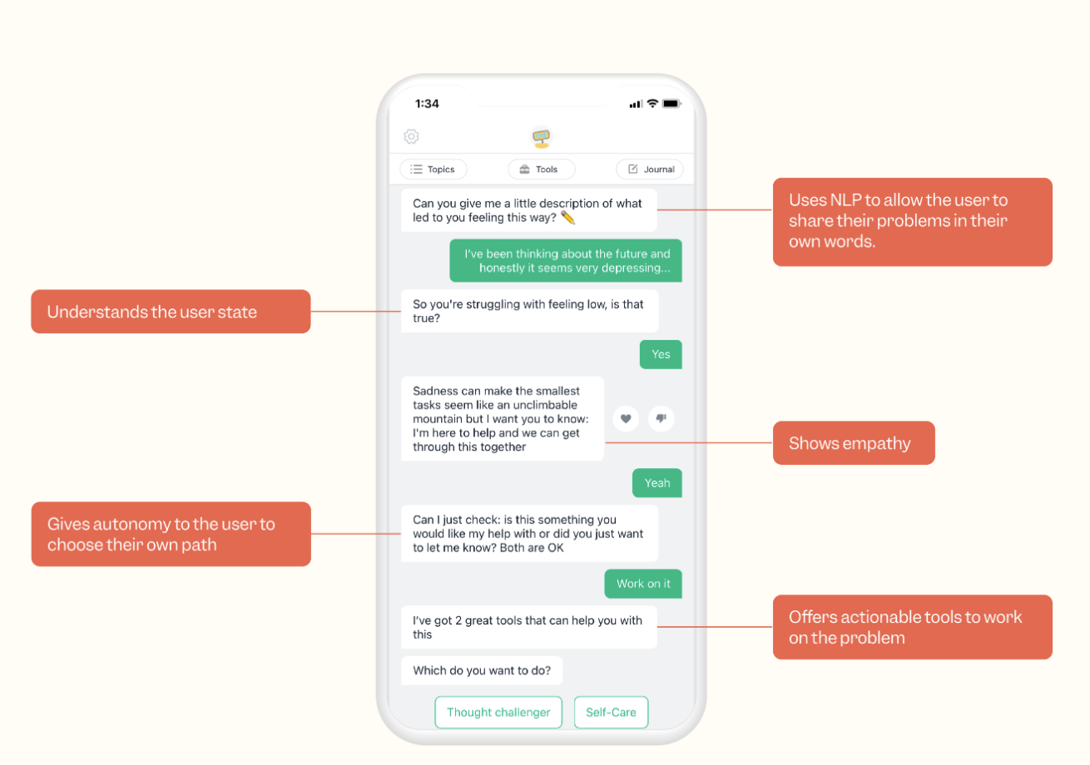
Analysis
Market trends
1 billion people worldwide need Mental Health Support
Cost impact: USD 2.5 trillion to grow USD 6 trillion by 2030
Remote employees feel isolated.
Competition
Chatbots & Woebot - The user has to trigger
Different to Remote Workers Mental
Healthcare monitoring as this can be applied
proactively across the workforce
Source: Woebot Health. (2023, November 1). Relational Agent for Mental Health | Woebot Health. https://woebothealth.com/

Slide 6
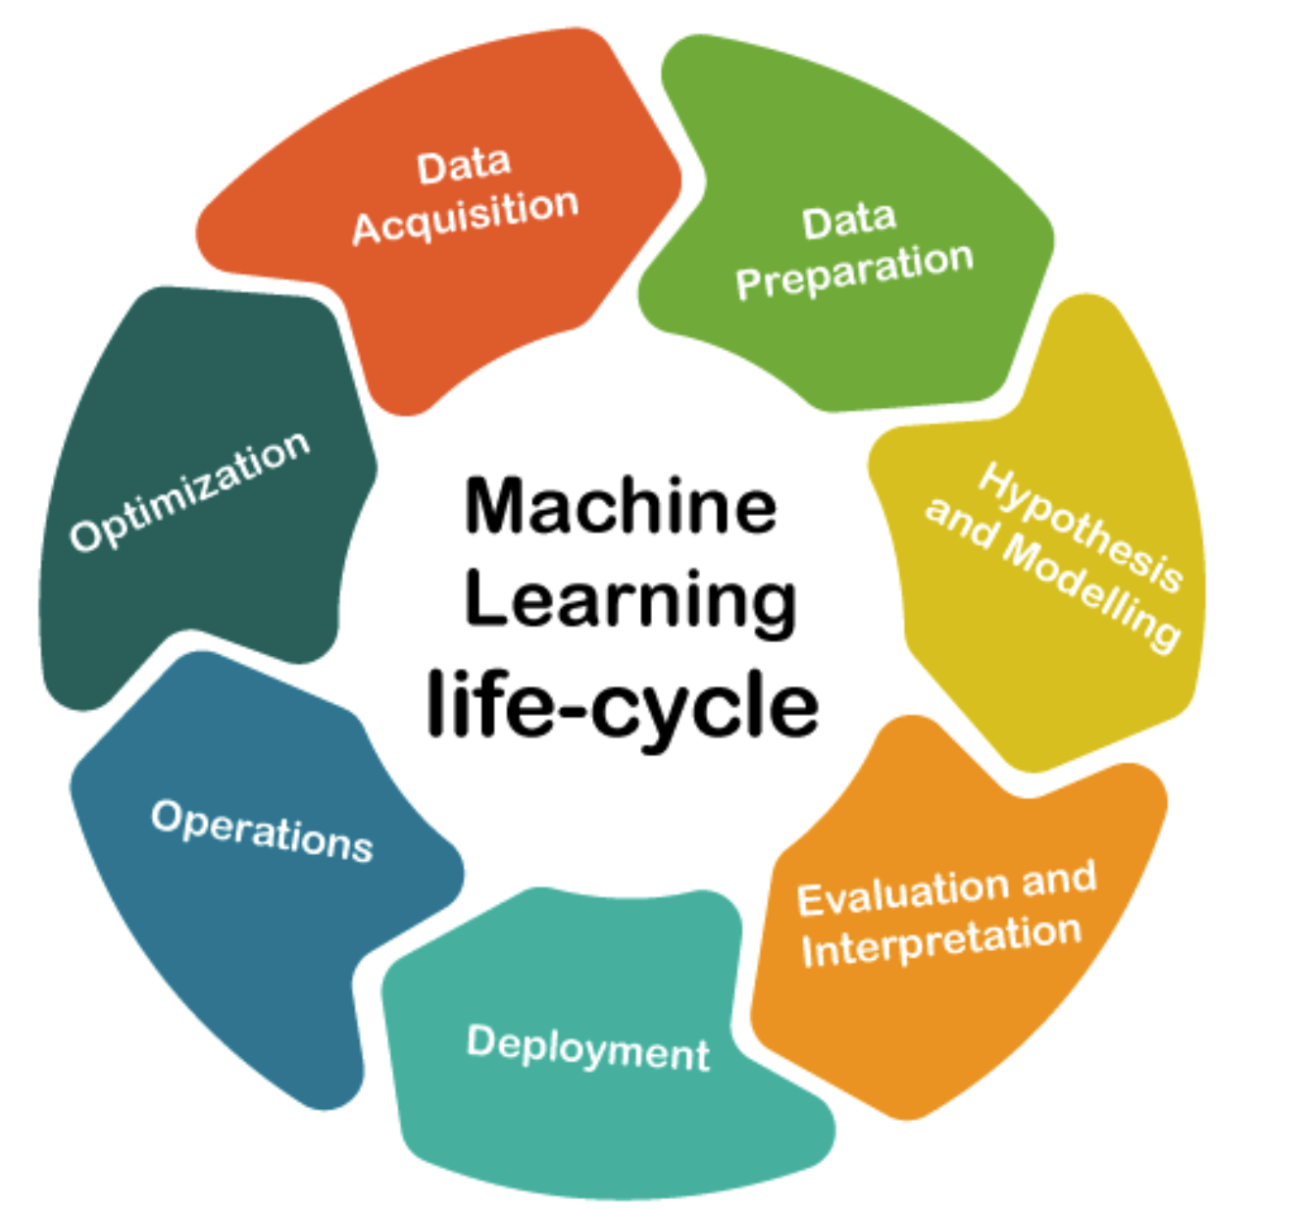
Analysis
Machine Learning Life Cycle:
1. Data acquisition: Surveys, wearable devices, activity logs, self-reported mental health assessments
2. Data preparation: Removing outliers, missing values
3. Hypothesis and Modelling: Programming to derive meaningful insights from the data - monitor activity levels,sleeping patterns and survey responses. Develop indicators that correlate with mental health states.
4. Evaluation and interpretation: After training the model, we evaluate the model based on predefined mental health outcomes and KPIs – to determine the level of accuracy.
5. Deployment: Application of the model on cloud or onsite deployment
6. Operations: Monitoring performance and developing user-friendly interfaces for employees and employers. Develop robust security measures to protect data and adherence to ethical standards.
7. Optimization: Learning model into production, enhancing for better features and documentation of methodologies, Model changes, and performance metrics.
Source: Tutorial and Example. (2020, November 21). Machine Learning Life Cycle.

Slide 7
Analysis
Analysis , Risks & ROI
Comparative Analysis & Risks
Key Financial Metrics
What to keep you awake at night
The payback period for the investment is 4 years, indicating the time it takes to recoup the initial investment.
The investment multiple is 1:5, showcasing the cumulative return on investment over 5 years.
The annual growth of the mental health apps market is 142%, highlighting the market growth rate.
The system's cumulative revenue in 5 years beyond what is expected
What to wake for in morning
Offers continuous monitoring to detect early signs of stress, anxiety, and burnout
Potentially prevents mental health issues and the associated costs in remote work settings
Transformative approach compared to conventional methods
Substantial initial financial investment for development and implementation
Uncertainties regarding the return on investment (ROI)
Disparities in technological access and digital literacy could limit the system's effectiveness

Slide 8
Analysis
Synergies & Impact
Synergies with Other Businesses
The system could integrate with existing health information systems to provide a more comprehensive view of a worker's health, enhancing the continuity of care.
Social Impact
The system aims to improve the mental health of remote workers, leading to increased productivity, job satisfaction, and reduced stigma associated with mental health issues.
Environmental & Further Innovations
The system could reduce carbon emissions by decreasing the need for workers to travel to in-person appointments, and it could also be an enabler for further innovations in AI-powered mental health solutions.

Slide 9
Conclusion
There is a need for a Mental Health Monitoring system for remote workers - which is different to the existing Mental Health chatbots and Woebot
Hosted on a secure platform - ensures data privacy and system security
The integration and universal accessibility and convenience - early and accurate detection of stress and fatigue
Adopting Behavioural Pattern analysis with AI - predictive modelling where AI can be used to help detect early signs of stress and burnout - using the power of AI to positively contribute to Mental Health well being and society.

Slide 10
References
Mayer, K. (2023, March 10). A Potential Downside to Remote Work? Higher Rates of Depression. SHRM. https://www.shrm.org/resourcesandtools/hr-topics/benefits/pages/remote-workers-experiencing-higher-rates-of-depression.aspx
Healthsnap. (2023, September 6). AI in Remote Patient Monitoring: The Top 4 Use Cases in 2023. HealthSnap, Inc. https://healthsnap.io/ai-in-remote-patient-monitoring-the-top-4-use-cases-in-2023/
Mental Health Monitoring System using Artificial Intelligence: A Review. (n.d.). IEEE Conference Publication | IEEE Xplore. https://ieeexplore.ieee.org/abstract/document/9033652
Rathnayaka, P., Mills, N., Burnett, D., De Silva, D., Alahakoon, D., & Gray, R. (2022). A Mental Health Chatbot with Cognitive Skills for Personalised Behavioural Activation and Remote Health Monitoring. Sensors, 22(10), 3653. https://doi.org/10.3390/s22103653
Woebot Health. (2023, November 1). Relational Agent for Mental Health | Woebot Health. https://woebothealth.com/
Xiao, Y., Becerik-Gerber, B., Lucas, G. M., & Roll, S. C. (2020). Impacts of Working from home during COVID-19 Pandemic on Physical and Mental Well-Being of Office Workstation Users. Journal of Occupational and Environmental Medicine, 63(3), 181–190. https://doi.org/10.1097/jom.0000000000002097
Zheng, Z. and Wei, W. (2015) An effective contrast sequential pattern mining approach to Taxpayer Behavior Analysis - World Wide Web, SpringerLink. Available at: https://link.springer.com/article/10.1007/s11280-015-0350-4.
Syed Mohamed (2023) A hybrid mental health prediction model using support vector machine, multilayer perceptron, and random forest algorithms, Healthcare Analytics. Available at: https://www.sciencedirect.com/science/article/pii/S2772442523000527?via%3Dihub.

